Slide 1
Rejection region and Error probabilities

Slide 2
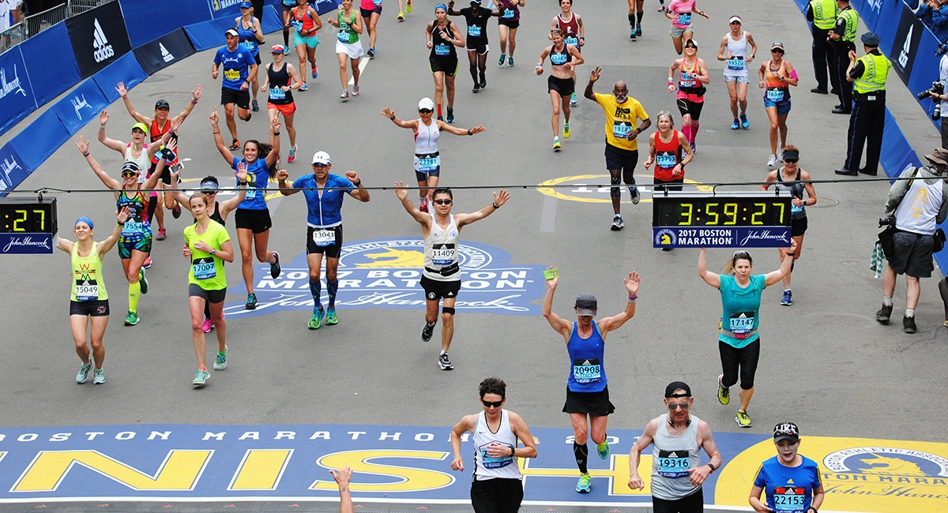
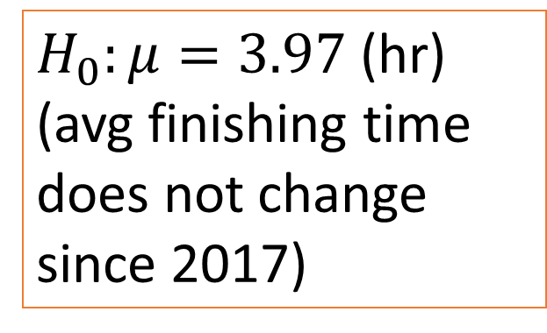

Recap: Hypothesis testing
1. Formulate the null hypothesis $H_{0}$
$H_{0}:μ=3.97$ (hr)
(avg finishing time does not change since 2017)

Slide 3
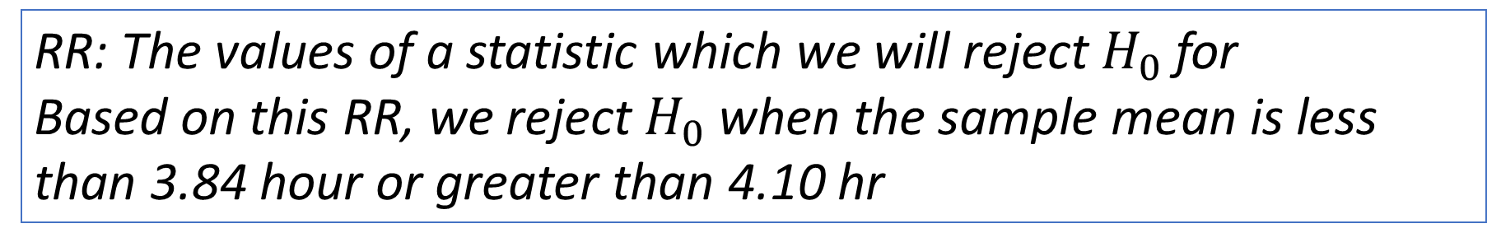
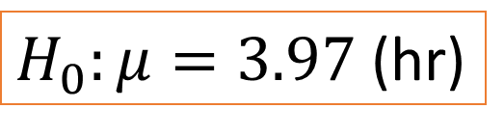

Rejection region (RR)
$H_{0}:μ=3.97$ (hr)
Assume H0 is true (and $σ^{2}$ is known, for now)$⇒\overline{X_{n}}\sim N(3.97,σ^{2}/n)$
Set a “reasonable” region around 3.97 for which $H_{0}$ will be rejected
an arbitrary choice could be to reject $H_{0}$ when $\overline{X_{n}}$ is not in $3.97±0.13$
RR
RR
3.84
3.97
4.10
Avg finishing time
(sample mean)
RR: The values of a statistic which we will reject $H_{0}$ for
Based on this RR, we reject $H_{0}$ when the sample mean is less than 3.84 hour or greater than 4.10 hr

Slide 4
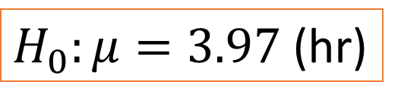


Type-1 error probabilities
$H_{0}:μ=3.97$ (hr)
Suppose $H_{0}$ is indeed true. There is a chance that the sample mean will fall in RR $⇒$ We reject $H_{0}$ while it’s true (of course we won’t know that)
This error is called a TYPE-1 ERROR
$⇒$ What is the probability of Type-1 errors?
$$\overline{X_{n}}\sim N(3.97,σ^{2}/n)$$
RR
RR
3.84
3.97
4.1
Avg finishing time
(sample mean)

Slide 5

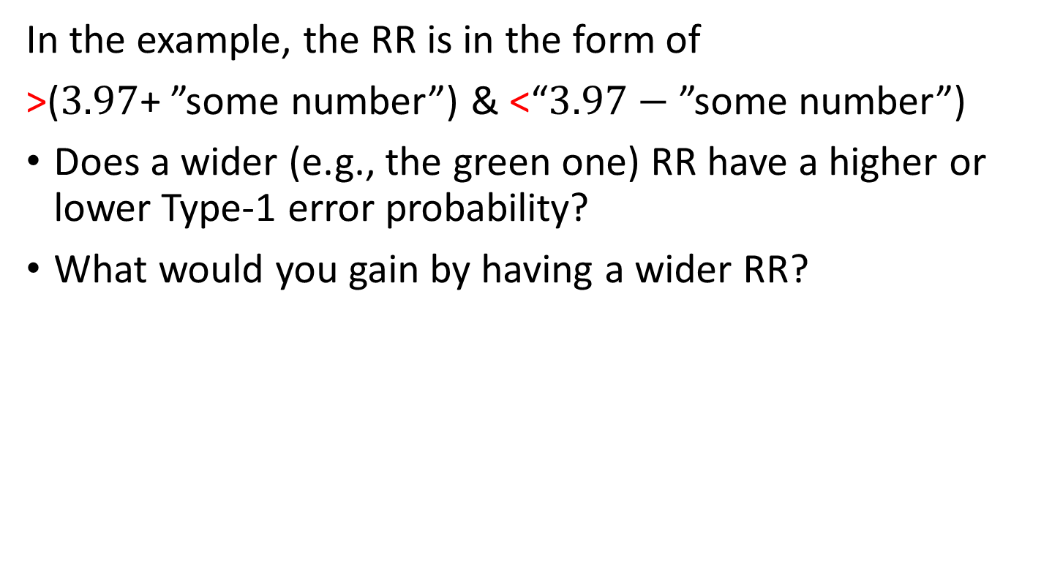
In the example, the RR is in the form of
>($3.97$+ ”some number”) & <“$3.97−$ ”some number”)
Does a wider (e.g., the green one) RR have a higher or lower Type-1 error probability?
What would you gain by having a wider RR?
RR
RR
RR
RR
3.97
Avg finishing time
(sample mean)

Slide 6
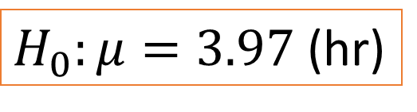

Type-2 error probabilities
$H_{0}:μ=3.97$ (hr)
Conversely, when $H_{0}$ is false, there will still be a chance that the sample mean will NOT appear in RR $⇒$ We fail to reject $H_{0}$ while it’s false (again we won’t know when the error happened)
This error is called a TYPE-2 ERROR
$⇒$ What is the probability of Type-2 errors, if $μ$=4.0?
RR
RR
3.84
3.97
4.1
Avg running time
(sample mean)

Slide 7
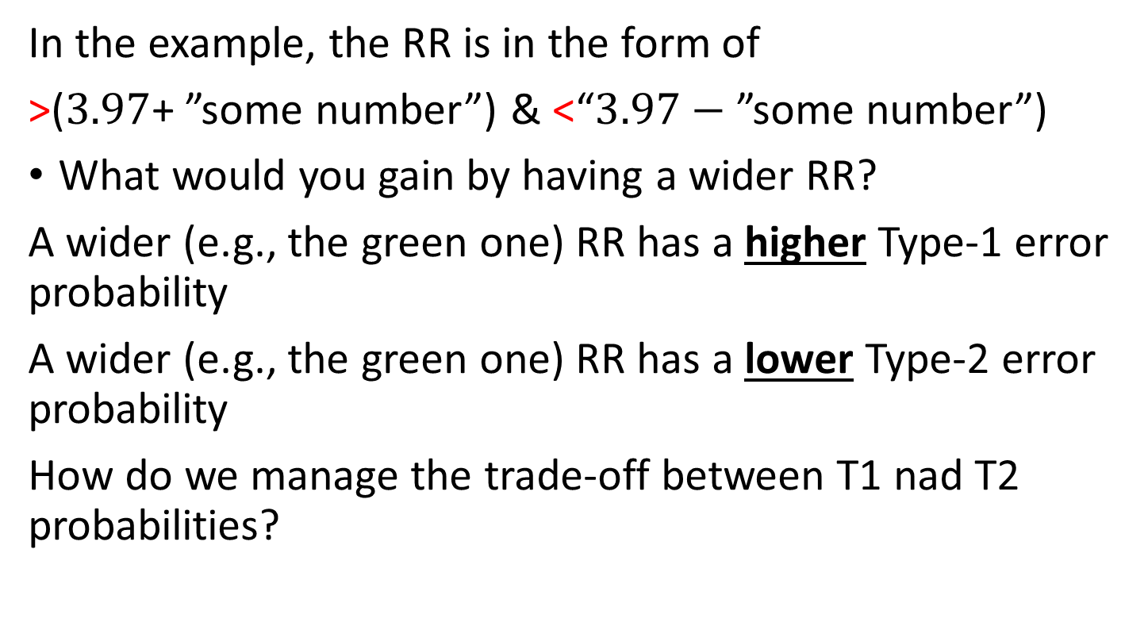
In the example, the RR is in the form of
>($3.97$+ ”some number”) & <“$3.97−$ ”some number”)
What would you gain by having a wider RR?
A wider (e.g., the green one) RR has a higher Type-1 error probability
A wider (e.g., the green one) RR has a lower Type-2 error probability
How do we manage the trade-off between T1 nad T2 probabilities?
RR
RR
RR
RR
3.97
Avg finishing time
(sample mean)

Slide 8
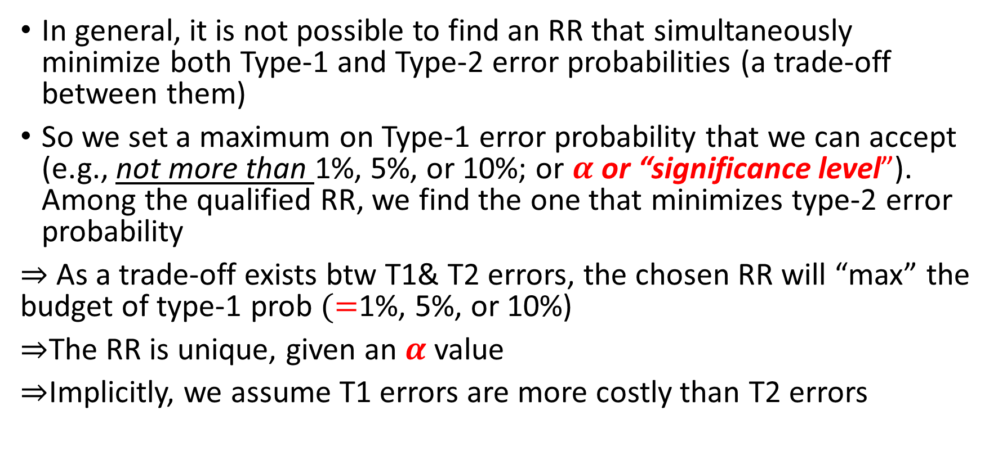
Balancing error probabilities
In general, it is not possible to find an RR that simultaneously minimize both Type-1 and Type-2 error probabilities (a trade-off between them)
So we set a maximum on Type-1 error probability that we can accept (e.g., not more than 1%, 5%, or 10%; or $α$ or “significance level”). Among the qualified RR, we find the one that minimizes type-2 error probability
$⇒$ As a trade-off exists btw T1& T2 errors, the chosen RR will “max” the budget of type-1 prob $(=$1%, 5%, or 10%)
$⇒$The RR is unique, given an $α$ value
$⇒$Implicitly, we assume T1 errors are more costly than T2 errors

Slide 9
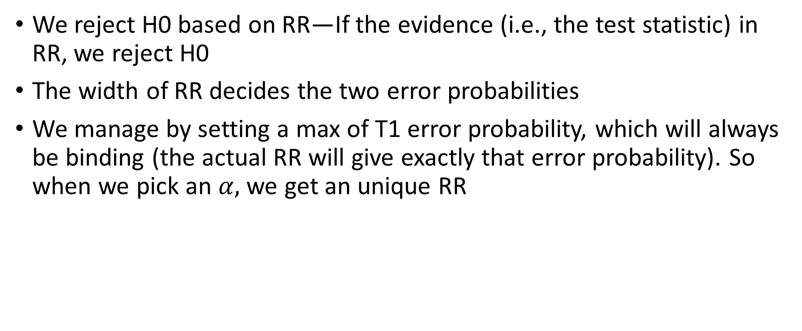
Summary
We reject H0 based on RR—If the evidence (i.e., the test statistic) in RR, we reject H0
The width of RR decides the two error probabilities
We manage by setting a max of T1 error probability, which will always be binding (the actual RR will give exactly that error probability). So when we pick an $α,$ we get an unique RR

